Slide 1
2
Central Tendency and Variability

Slide 2
Central Tendency
Question: How can a group of scores be summarized with a single number?

Slide 3
Measures of Central Tendency
Central tendency: most “typical” or common score
  Mode
  Median
  Mean

Slide 4
Mode -1
Most frequently occurring number in a distribution
Mode of dataset 7,8,8,7,3,1,6,9,3,8 = 8
Measure of central tendency for nominal variables

Slide 5
Mode -2
Using the example of the number of dreams during a week for 10 students, the mode is the high point in the distribution’s histogram

Slide 6
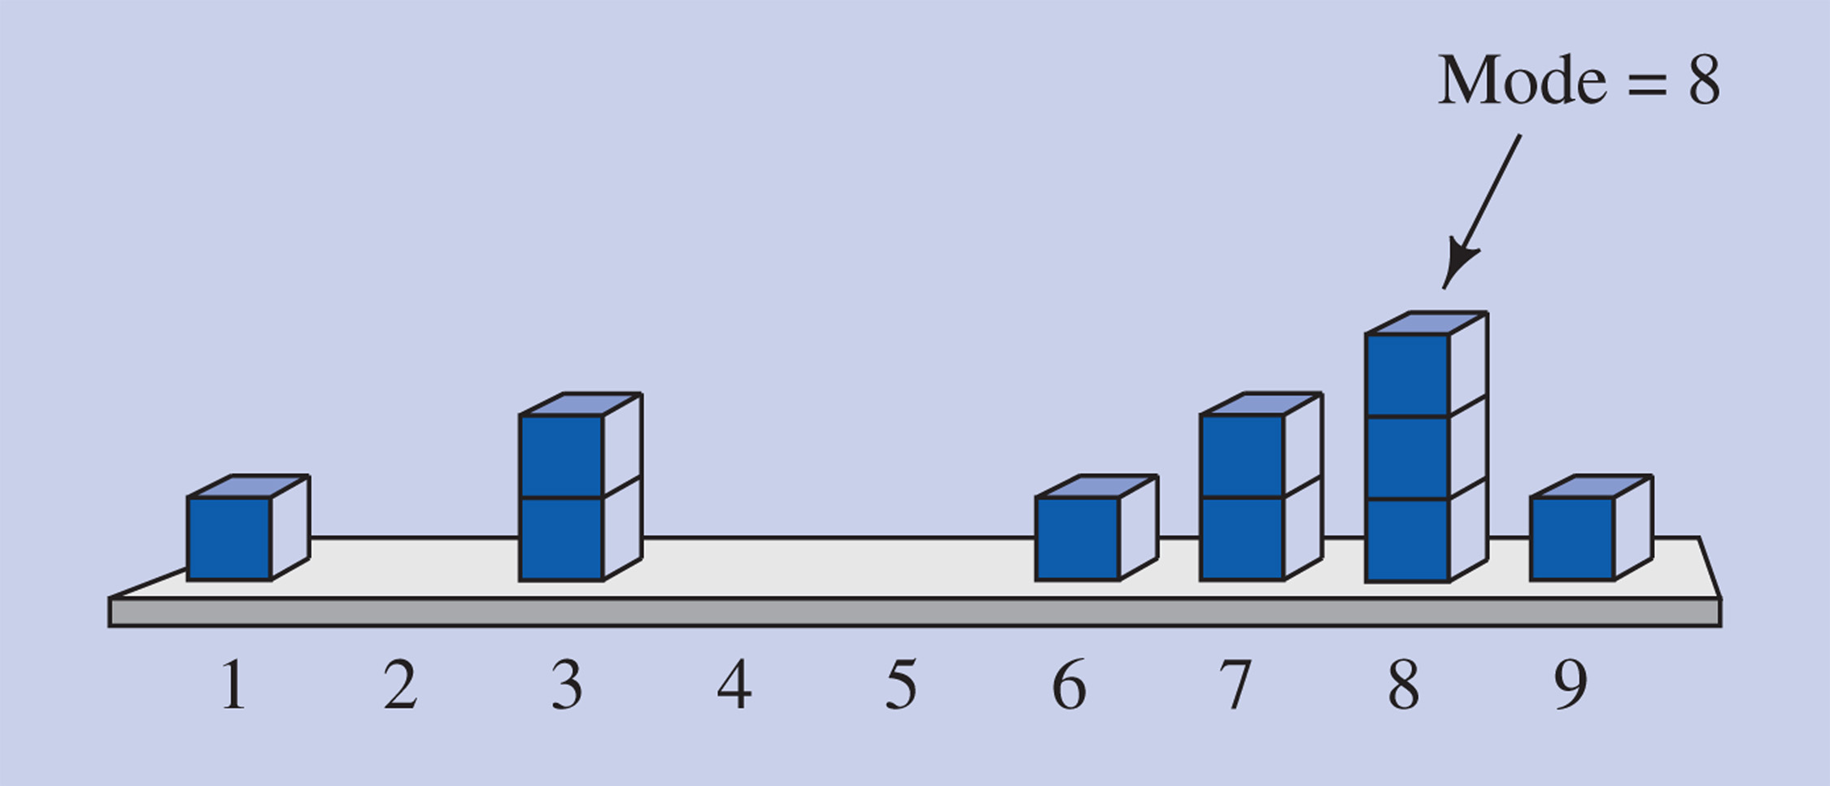
Figure 2-5 Mode as the high point in a distribution’s histogram, using the example of the number of dreams during a week for 10 students.

Slide 7
Median -1
Median: the value at which 1/2 of the ordered scores fall above and 1/2 of the scores fall below
1 2 3 4 5 1 2 3 4
Median = 3
Median = 2.5

Slide 8
Median -2
The middle score when all scores are arranged from lowest to highest
Median of 7,8,8,7,3,1,6,9,3,8
    1 3 3 6 7 7 8 8 8 9
  ↑
  median
    The median is the average (mean) of the 5th and 6th scores, so the median is 7

Slide 9
Median -3
Used when a distribution is highly skewed
  Income
  Number of kids

Slide 10
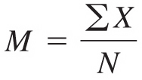
Mean -1
Sum of all the scores divided by the number of scores
Most commonly used with ratio scales

Slide 11
Mean -1
Mean of 7,8,8,7,3,1,6,9,3,8
  ΣX = 7+8+8+7+3+1+6+9+3+8 = 60
  N = 10
  Mean = 60/10 = 6

Slide 12
Mean -2
Mean of the distribution of the number of dreams during a week for 10 students

Slide 13
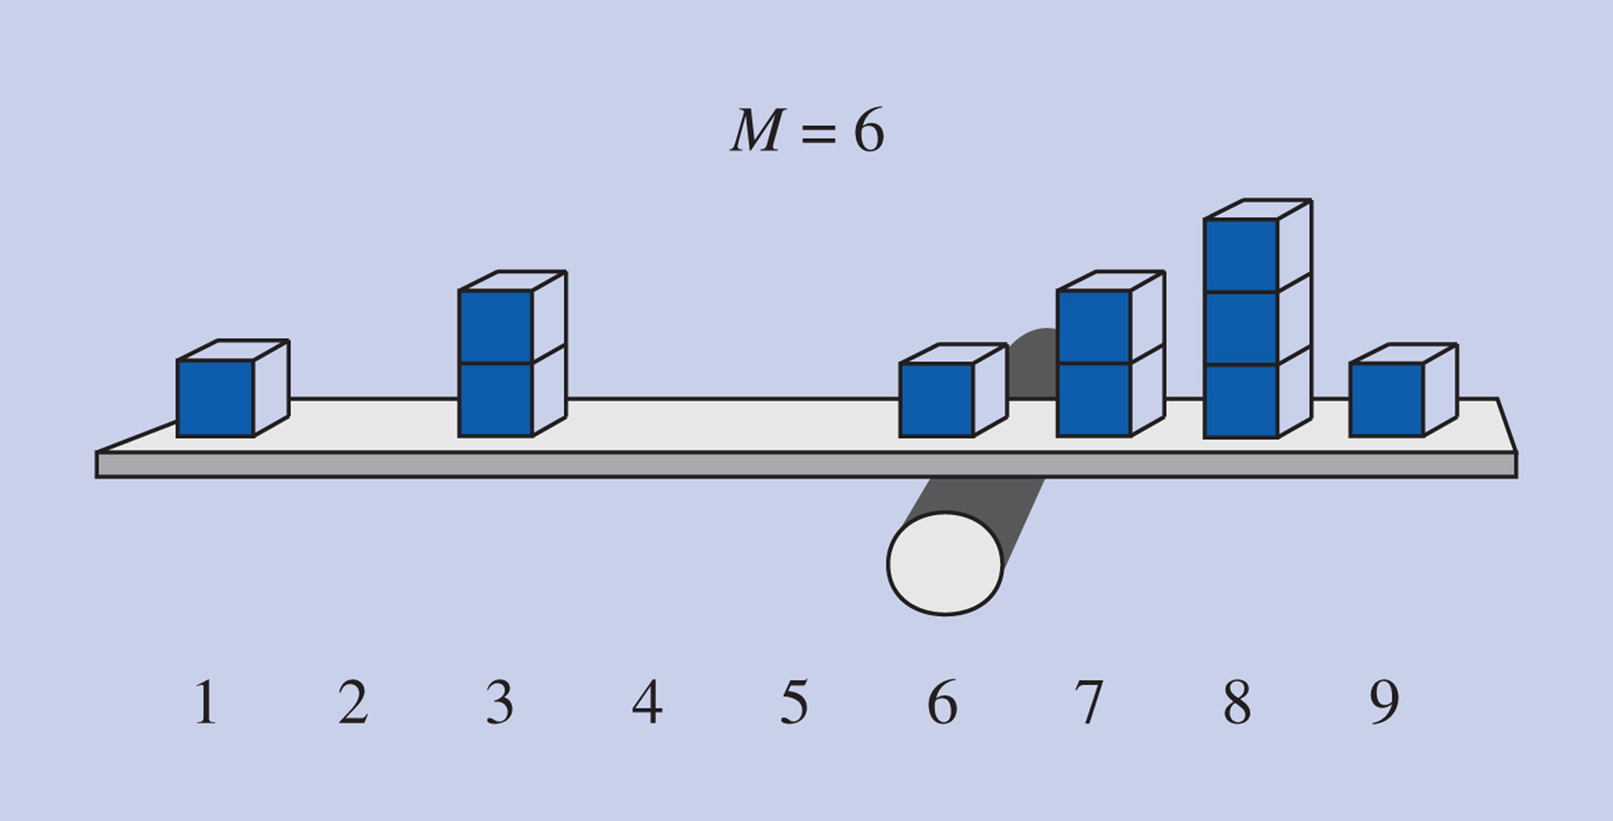
Figure 2-1 Mean of the distribution of the number of dreams during a week for 10 students, illustrated using blocks on a board balanced on a log.

Slide 14
Measures of Central Tendency
In a normal distribution, the mean, median and mode coincide
In skewed distributions, the mean is “pulled” toward the tail of the distribution
  In a positively skewed distribution, the median is higher than the mean
  In a negatively skewed distribution, the median is lower than the mean

Slide 15
Advantages of the Mean
The mean is the most stable measure of central tendency because all the scores in a distribution are included in its calculation (not true to mode or median)
  Not as affected by addition or deletion of scores as mode and median
The mean is used in many statistical procedures

Slide 16
Comparing Central Tendency
Outliers – scores with an extreme value in relation to other scores on the distribution
  Usually affects the mean more the median or mode

Slide 17
Measures of Variability:
The Variance
The average of each score’s squared difference from the mean
How much the scores are “spread out”
Copyright © 2009 Pearson Education, Inc. Upper Saddle River, NJ 07458. All rights reserved.

Slide 18
Variance
Steps for computing the variance:
  1. Subtract the mean from each score
  2. Square each of these deviation scores
  3. Add up the squared deviation scores
  4. Divide the sum of squared deviations by the number of scores

Slide 19
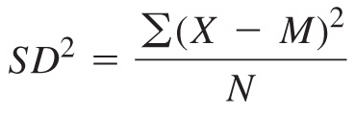
Formula for the Variance

Slide 20
Sum of Squares
SS!
The sum of squares is the first part of the variance formula E(X – M)²

Slide 21
Variance
Problem!
  Biased due to the scale you are using
    5 point scale can only vary between those 5 points
    100 point scale can vary a lot

Slide 22
Measures of Variability:
The Standard Deviation
Most common way of describing the spread of a group of scores
Steps for computing the standard deviation:
  Figure the variance
  Take the square root

Slide 23
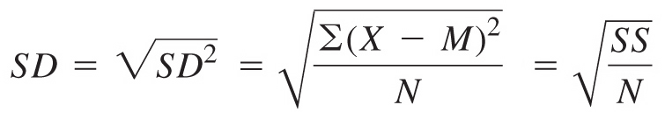
Formula for the
Standard Deviation

Slide 24
Standard Deviation
Why use it?
  Doesn’t variance say the same thing?
  No, this is standardized so you can compare apples to oranges

Slide 25
Interesting Issues
Caveat –
  Most people use a sample adjustment
  Instead of dividing by N, divide by N-1
  Better estimates the population
  Most programs do it this way
    Be sure to use N on the homework…

Slide 26
Controversies and Limitations:
The Tyranny of the Mean
Knowledge about the individual case is lost when taking averages
Qualitative research methods
  Ex.: case studies, ethnography

Slide 27
The Mean and Standard Deviation in Research Articles
Commonly reported in research articles

Slide 28
Explaining In English
Mean
Standard deviation

Slide 29
How To
Get these scores
  Mean, median, mode, standard deviation, variance, SS

